Slide 1

C-DAC ACTS
HIGH PERFORMANCE COMPUTING IN APPLICATION PROGRAMMING
Project on
Profiling Tool Development

Slide 2
Project : Team
Abhijeet Shinde
Aditya Bhalavi
Dipali Kothimbire
Poonam Waghmare
Sudhanshu Kamble
Project Head
Om Jadhav Sir
Project Guide
Himanshu Sharma Sir

Slide 3
Objective
To Develop an advanced High-Performance Computing (HPC) profiling tool that enables comprehensive analysis and optimization of parallel and distributed applications, facilitating improved program performance and resource utilization.
The tool goes beyond basic profiling capabilities and offers comprehensive analysis features for developers in identifying performance bottlenecks, optimizing parallel execution, and making efficient use of computing resources.
The ultimate aim is to enhance the overall performance of HPC applications, leading to faster computations and better resource allocation.

Slide 4
Profiling
What is Profiling ?
Profiling in the context of High-Performance Computing (HPC) refers to the practice of gathering and analyzing data about the performance of software applications or hardware systems to identify bottlenecks, optimize performance, and improve efficiency. Profiling techniques in HPC are used to gain insights into the behavior and performance characteristics of parallel and distributed applications running on large-scale computing systems.
Profiling used for :
Performance Analysis
Resource Utilization
Parallelism and Load Balancing
Code Optimization
Scalability Analysis

Slide 5
Literature Survey
Intel Advisor
The tool is designed to help programmers identify performance bottlenecks and provide insights into how to improve the efficiency of their applications.
HPCToolkit
HPC Toolkit is a tool for measurement and analysis of program performance on computers ranging from multicore desktop systems to the largest GPU-accelerated supercomputers.
Intel VTune
It empowers developers to enhance parallelism, and improve vectorization, resulting in faster and more efficient code execution.
TAU
TAU(Tuning and Analysis Utilities) toolkit is a comprehensive profiling and tracing toolkit.
LIKWID
LIKWID provides a set of tools and libraries which optimizes the performance of application.

Slide 6
In this project, we will be creating automation of 5 profiling tools HPCToolkit, TAU, LIKWID, Intel VTune and Intel Offload Advisor by creating shell scripts. We will be working on development of profiling tool on the basis of above tools. Final tool developed will be used to analyze the behaviour of any user application and find out its resource consumption.
Intel Advisior
HPCToolkit
Intel Vtune
TAU
LIKWID

Slide 7
Intel Advisior
Intel Offload Advisor is a powerful tool specifically tailored for the high-performance computing (HPC) domain.
Intel Offload Advisor is to assist developers in optimizing their applications for heterogeneous computing platforms.
In computing, "heterogeneous" describes a system where various components, such as processors, accelerator, and co-processors, come together to perform different tasks based on their specialized capabilities.
By offloading these tasks, developers can achieve higher performance, improved energy efficiency, and scalability.

Slide 8
Workflow
CPU-to-GPU Modeling:
CPU-to-GPU modeling refers to the process of offloading computations from a central processing unit (CPU) to a graphics processing unit (GPU) to enhance performance and efficiency.
Workflow:
The CPU identifies computationally intensive tasks that can be performed in parallel. It then transfers these tasks to the GPU, which processes them concurrently, resulting in faster execution times.
GPU-to-GPU Modeling:
GPU-to-GPU modeling involves utilizing multiple GPUs within a system to collaborate on a single computation, enabling even more parallelism and performance improvement.
Workflow: The problem is divided into smaller parts, and each part is assigned to a different GPU. The GPUs process their portions simultaneously, and the results are combined for the final output.

Slide 9
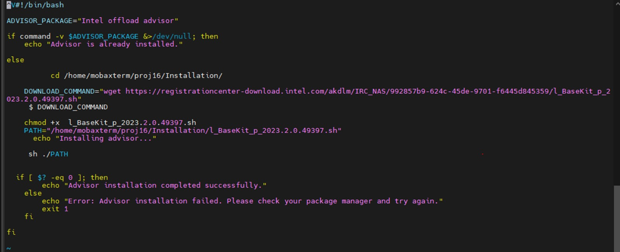
Intel Advisor Installation Script

Slide 10
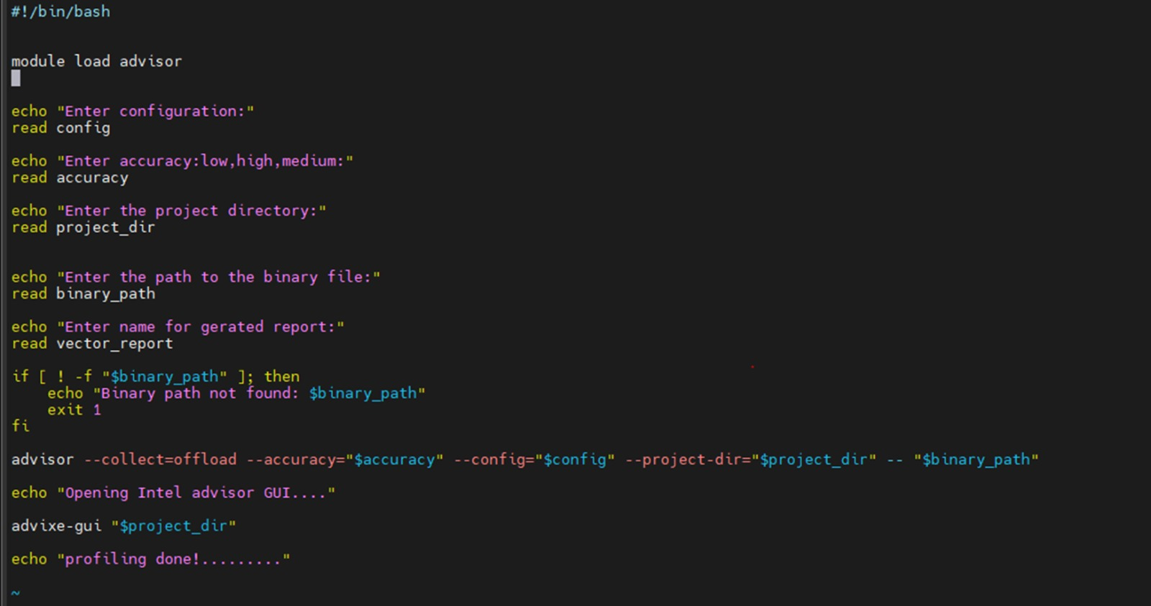
Intel Advisor Shell Script

Slide 11
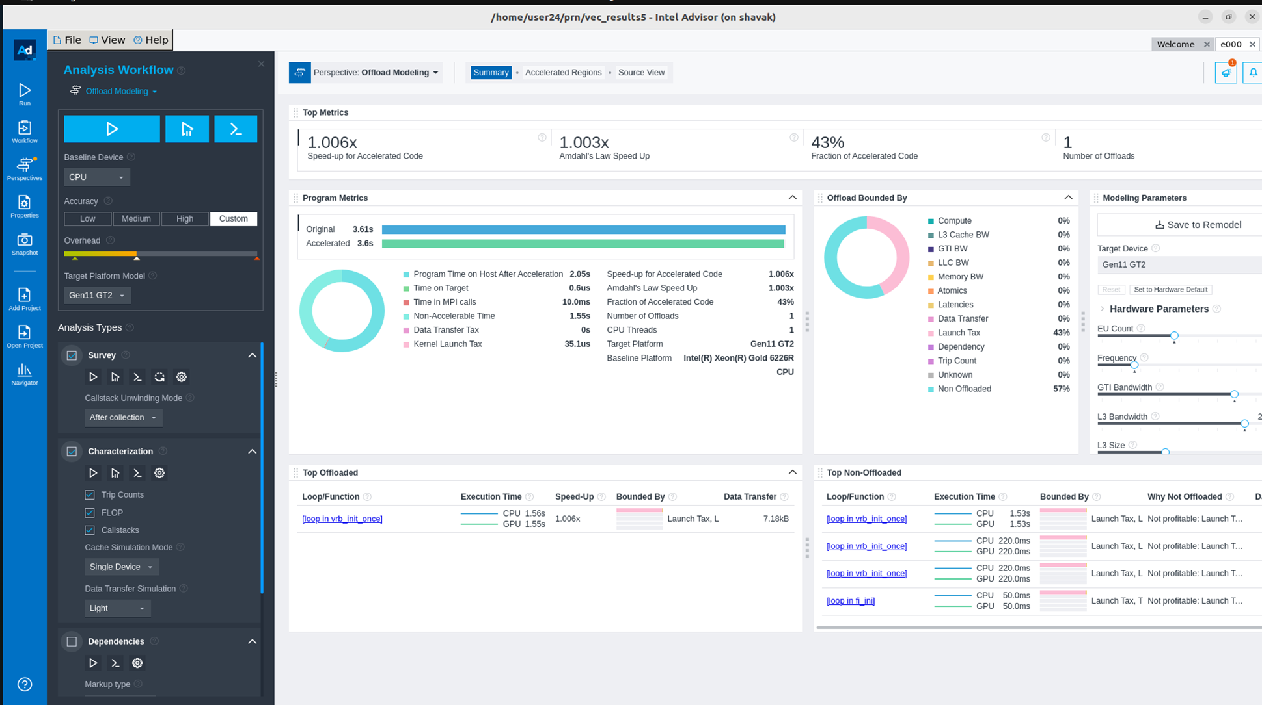
Output

Slide 12
HPCToolkit
HPCToolkit is a performance analysis tool suite designed for profiling and analyzing the performance of high-performance computing (HPC) applications. It is widely used by developers and researchers to understand the behavior of their applications, identify performance bottlenecks, and optimize code for better performance.
HPCToolkit supports various programming languages, including C, C++, and Fortran. It's commonly used in the HPC community to optimize applications for performance on supercomputers and clusters. By identifying performance bottlenecks and areas of inefficiency, developers can make targeted optimizations that lead to more efficient and faster-running applications.

Slide 13
The HPCToolkit suite includes various command that help in different aspects of performance analysis:
hpcrun: This is a binary instrumentation tool that collects data about the execution of an application. It inserts lightweight instrumentation code into the application's binary, allowing it to track various performance metrics such as time spent in functions, call paths, and memory usage.
hpcstruct: It helps in associating the performance data collected with the source code, enabling a more user-friendly representation of performance metrics in the context of the code.
hpcprof: This tool combines the instrumented binary, performance data, and mapping information to generate a profile that shows how much time is spent in various functions and call paths.
hpcviewer: This tool is used to visualize and explore the collected performance data. It provides an interactive graphical interface that allows users to analyze the application's behavior, identify performance hotspots, and understand the call path hierarchy.

Slide 14
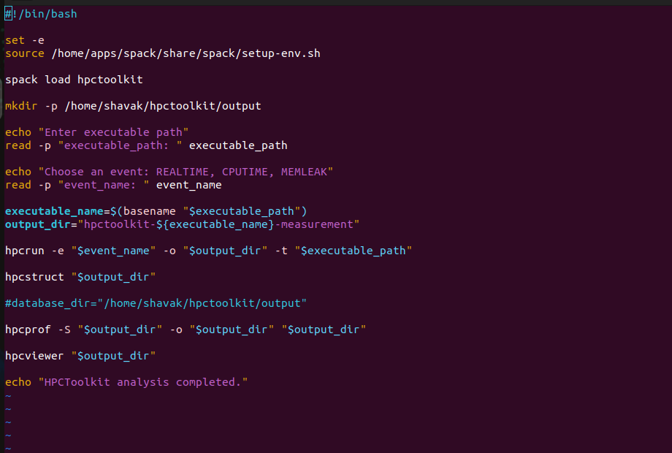
The shell script of hpctoolkit

Slide 15
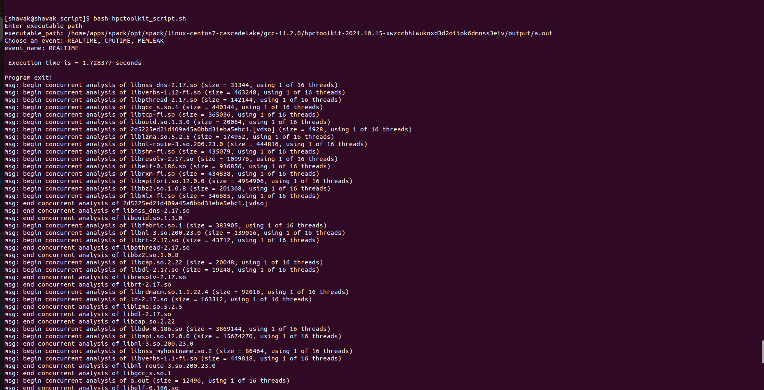
Output

Slide 16
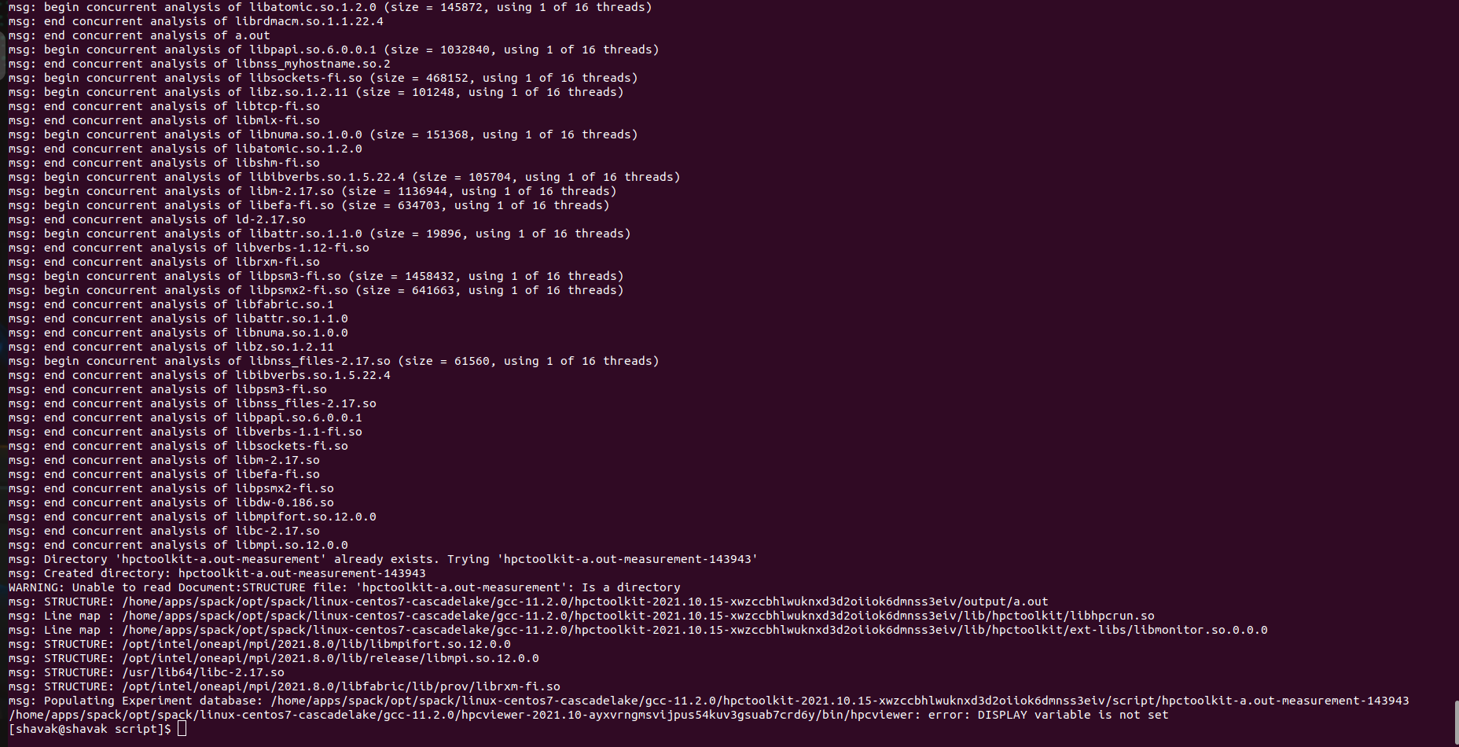

Slide 17
Intel Vtune
Intel VTune Profiler is a performance analysis tool developed by Intel to help developers optimize software applications for better performance on various hardware platforms.
Intel VTune Profiler is a powerful and versatile performance analysis tool with features that make it stand out from other profiling tools. Its comprehensive analysis capabilities, support for rich visualization, and integration with development tools make it an invaluable asset for developers to create high-performance applications.
VTune Tool Purposes:
Collect performance analysis data for your target application using your specified analysis type and other options.
Generate reports from analysis results.
Import data files collected remotely.
Compare performance before and after optimization.

Slide 18
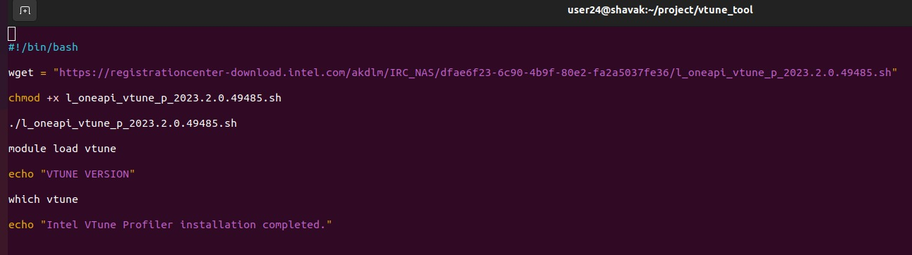
Vtune Installation Script

Slide 19
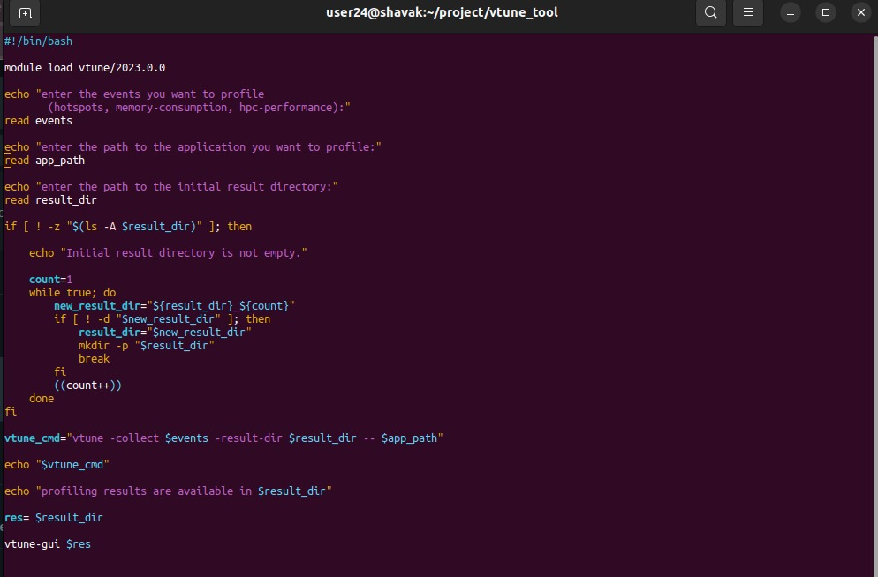
The shell script of Intel VTune

Slide 20
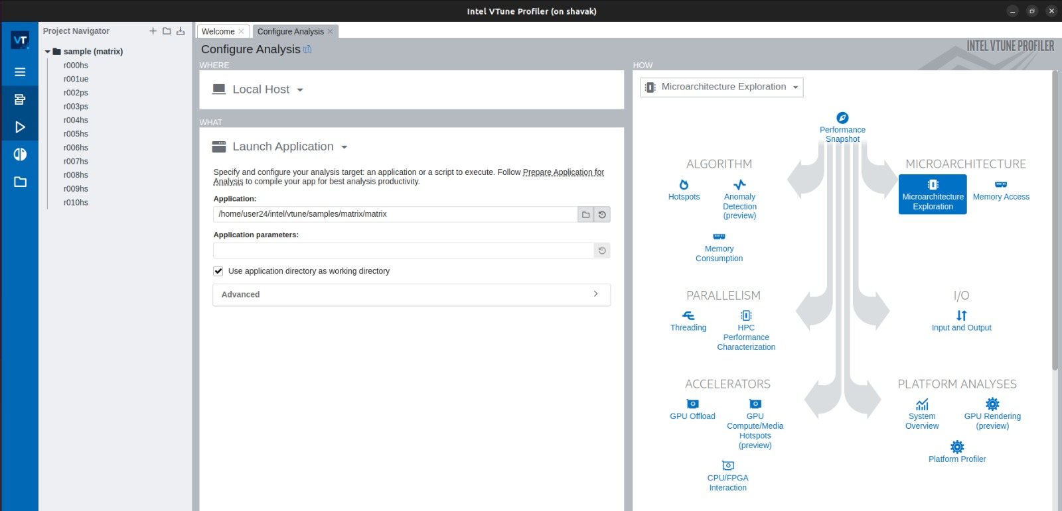
Output

Slide 21
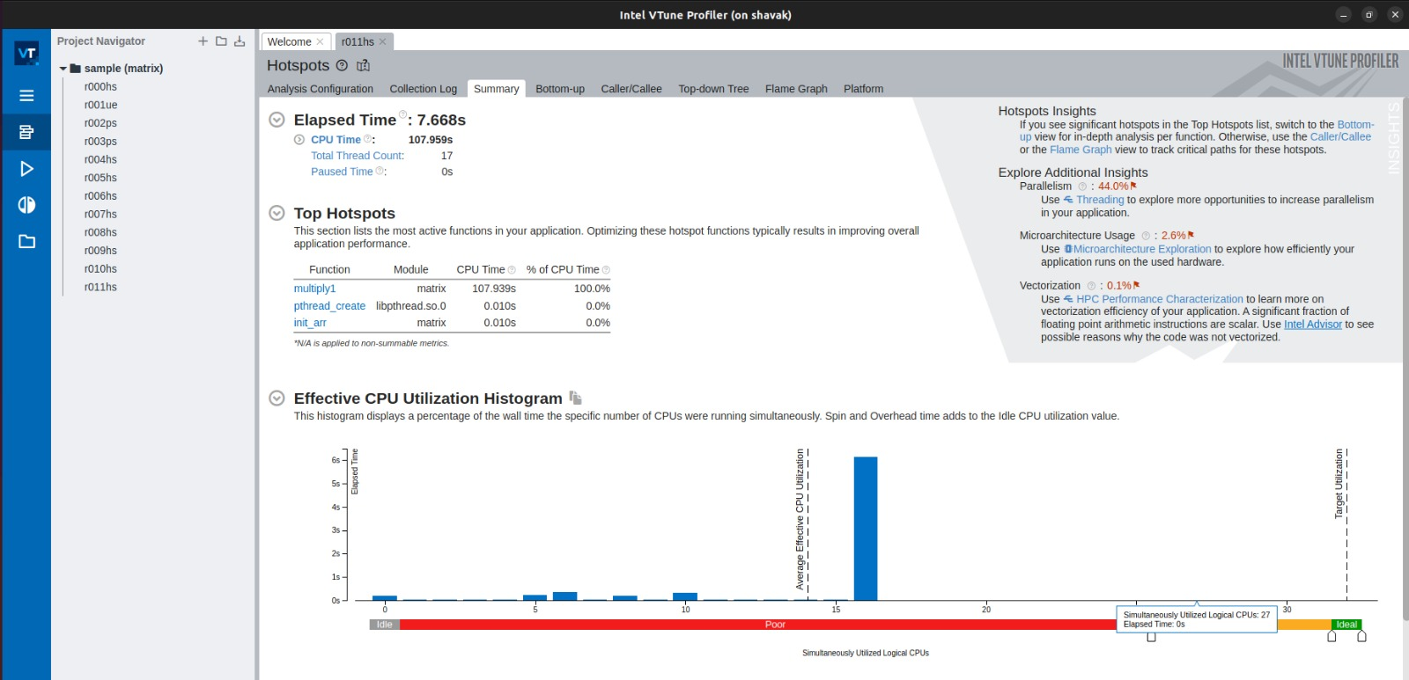

Slide 22
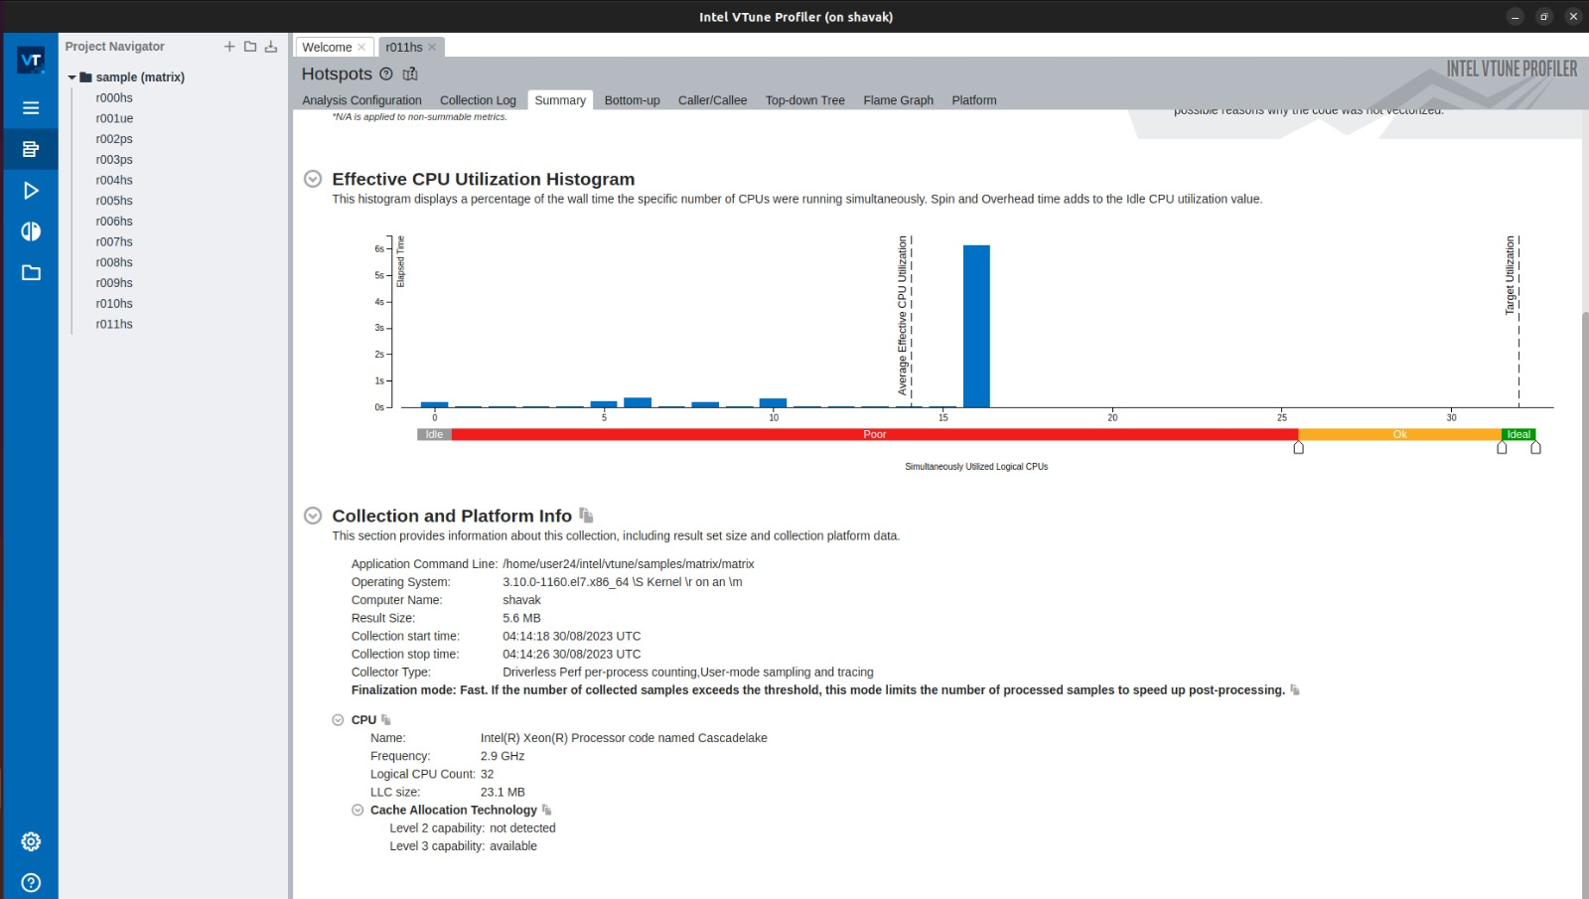

Slide 23
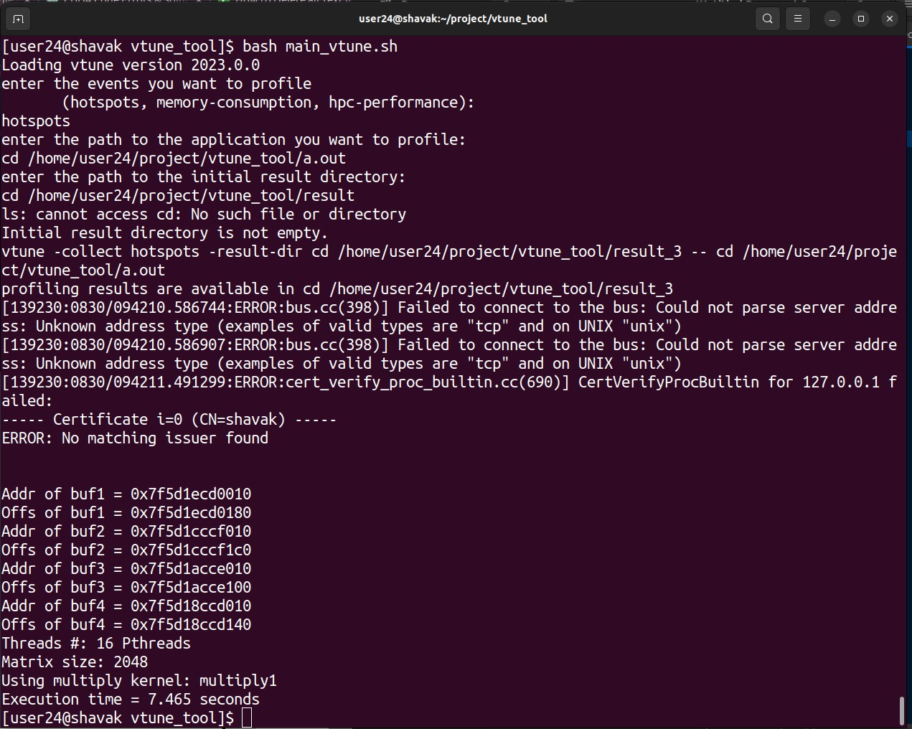

Slide 24
TAU
What is TAU?
TAU(Tuning and Analysis Utilities) is a comprehensive profiling and tracing toolkit.
TAU Performance System is a portable profiling and tracing toolkit for performance analysis of parallel programs written in Fortran, C, C++, UPC(Universal Product Code), Java, Python.
TAU can automatically instrument your source code using a package called PDT for routines, loops, I/O, memory, phases, etc.
TAU runs on most High Performance Computing platforms and it is free
TAU provides a comprehensive set of profiling and analysis capabilities that enable developers to gain deep insights into their code execution and identify areas for improvement. By utilizing TAU, developers can optimize their code, reduce execution time, and make the most efficient use of available resources.

Slide 25
TAU Architecture and Workflow
Instrumentation: Add probes to perform measurements
• Source code instrumentation using pre-processors and compiler scripts
• Wrapping external libraries (I/O, MPI, Memory, CUDA, OpenCL, pthread)
• Rewriting the binary executable
Measurement: Profiling or tracing using various metrics
• Direct instrumentation (Interval events measure exclusive or inclusive duration)
• Indirect instrumentation (Sampling measures statement level contribution)
• Throttling and runtime control of low-level events that execute frequently
• Per-thread storage of performance data
• Interface with external packages (e.g. PAPI how performance counter library)
Analysis: Visualization of profiles and traces
• 3D visualization of profile data in paraprof tool
• Trace conversion & display in external visualizers (Vampir, Jumpshot, ParaVer)

Slide 26
Key Features:
The TAU (Tuning and Analysis Utilities) toolkit offers several key features and functionalities that make it a powerful tool for profiling and analyzing the performance of parallel and distributed applications. Some of its features are:
Support for Multiple Programming Models: TAU supports various programming models and environments commonly used in HPC, including MPI, OpenMP, CUDA, UPC, SHMEM, and more.
Instrumentation Flexibility: TAU provides flexible instrumentation options. It supports both source code instrumentation and binary instrumentation techniques.
Comprehensive Performance Data Collection: TAU collects a wide range of performance data during application execution. It captures metrics such as CPU time, memory usage, I/O operations, synchronization overheads, communication patterns, and more

Slide 27
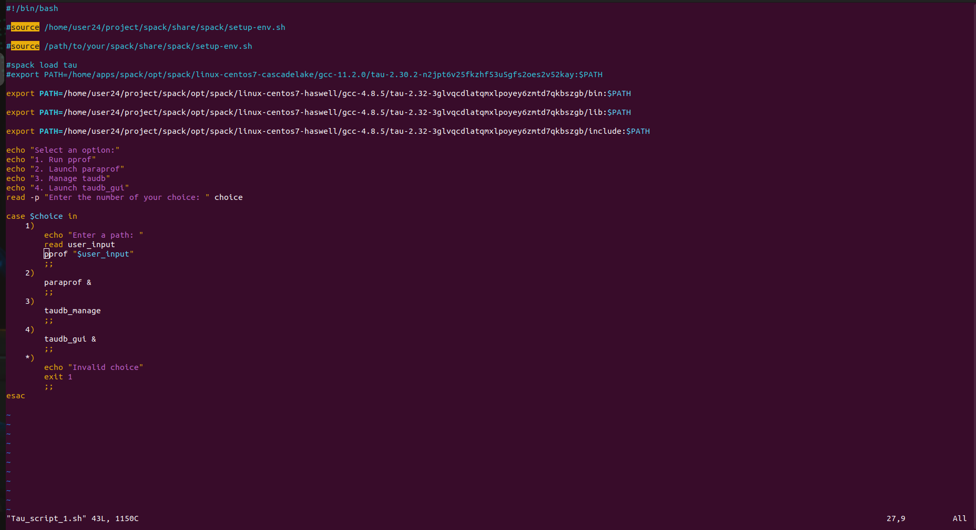
TAU Shell Script

Slide 28
LIKWID
Likwid is a widely used tool in the field of High-Performance Computing (HPC) that helps in performance analysis and optimization of parallel applications.
Likwid stands for "Like I Knew What I'm Doing" and it provides a set of command-line utilities and a programming API for accessing hardware performance counters and other low-level performance metrics.
The Likwid tool is primarily focused on analyzing the performance of x86-based processors, especially those with support for Performance Monitoring Units (PMUs).
It allows users to gather detailed information about the performance characteristics of their applications by measuring metrics such as cache utilization, instruction counts, floating-point operations, memory bandwidth, and many others.

Slide 29
Some key features and functionalities of Likwid include
Hardware Performance Counters: Likwid enables users to access and utilize the hardware performance counters available on modern processors. These counters can provide insights into low-level performance events and bottlenecks.
CPU Profiling: The tool allows for profiling the performance of individual processor cores, including metrics like instruction and cycle counts, cache misses, and pipeline stalls.
Memory Profiling: Likwid can analyze the memory behavior of an application, providing information on memory bandwidth usage, cache utilization, and cache misses.
Thread Analysis: It offers features for profiling and analyzing the behavior of multithreaded applications, such as measuring thread synchronization overhead and identifying load imbalances.
Energy Measurement: Likwid can also measure the energy consumption of an application, providing insights into power efficiency and optimization opportunities.

Slide 30
The LIKWID suite includes various command that help in different aspects of performance analysis:
likwid-topology : Display the thread and cache topology on multicore/multisocket computers
likwid-perfctr : Count hardware performance events. It can be used as wrapper application, which does not require modification of the code to be analyzed
likwid-pin : Pin the threads of an application without changing the code. Works for OpenMP, C++11 threads, pthreads, etc.
likwid-bench : A benchmarking framework that allows rapid prototyping of threaded assembly kernels.
likwid-powermeter : Access RAPL counters (for energy measurements) .
likwid-setFrequencies : Set the clock frequency of CPU cores.

Slide 31
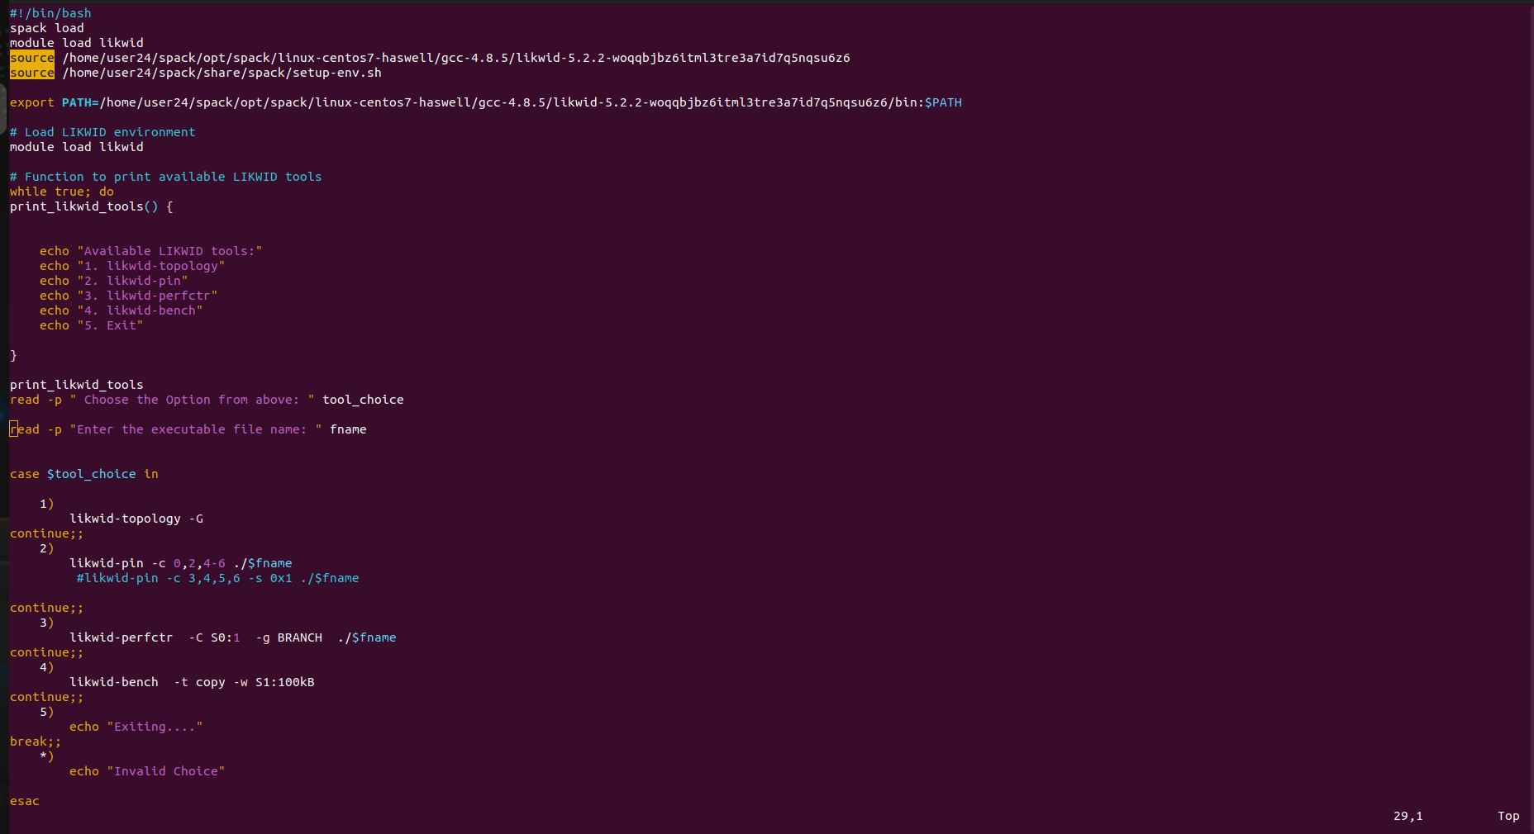

Slide 32
Conclusion
In conclusion, the development of our profiling tool was an enlightening experience that allows us to develop one profiling toolkit that combines the features of five different toolkits we have used.
The choice of a profiling tool depends on the specific goals, application domain, and hardware platform. Developers seeking to optimize performance should consider the features of these tools and choose the one that aligns best with their requirements.
The project is not only expanded our understanding of profiling techniques but also the importance of selecting the right tool for the task.
The ongoing evolution of these tools ensures that software developers have robust toolkit to analyze, optimize, and enhance the performance of their applications in an increasingly demanding computing landscape.

Slide 33
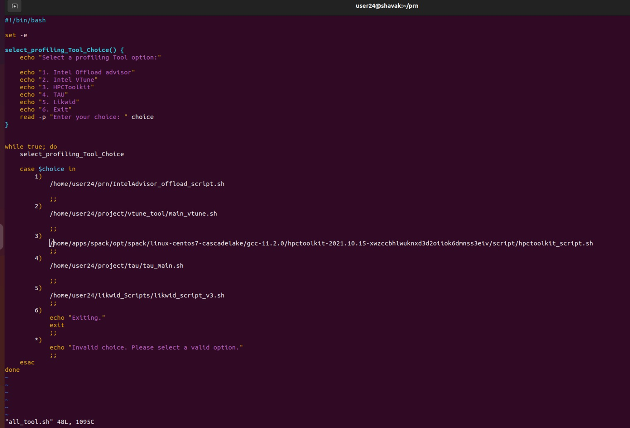
Main .sh

Slide 34
Future Scope
Performance Portability: As software spans various hardware architectures, from traditional CPUs to GPUs, FPGAs, and accelerators, profiling tools will need to offer performance analysis across heterogeneous platforms.
Tools that can analyze code behavior and performance on different architectures will be essential for optimizing applications for various target systems.
Server less and Function-as-a-Service: These tools will help developers optimize server less functions for better execution times and resource utilization.

Slide 35
THANK YOU!

